Slide 1
BACTERIAL MENENGITIS

Slide 2
Meningitis is a common name for infections (inflammation) that take place in the meninges surrounding the brain and spinal cord.
One of the most serious forms of meningitis is Meningococcal meningitis. It is caused by Neisseria meningitidis.
An infection with meningococcal bacteria causes a serious, potentially fatal infection called meningococcal disease.You may have heard it referred to as bacterial meningitis. Meningococcal disease can also cause a very serious condition called sepsis (blood poisoning).

Slide 3
TYPES OF MENENGITIS
Aseptic meningitis: caused by viruses (e.g. mumps), SLE, and some types of medications.
Bacterial meningitis: caused by a bacterial infection. Numerous microorganisms may cause bacterial meningitis:
Neiseria meningitidis
Streptococcus pneumoniae
Listeria monocytogenes
Haemophilus influenzae (type B)
Mycobacterium tuberculosis
Group B Streptococci
Escherichia coli

Slide 4
TYPES OF MENENGITIS CONT
Viral meningitis: caused by viruses (enterovirus).
Tuberculous meningitis: caused by tuberculosis infection due to Mycobacterium tuberculosis.
Cryptococcal meningitis: caused by infection from a yeast called Cryptococcus (found in soil and bird droppings). Often associated with AIDS.
Neoplastic meningitis: caused by the spread of solid tumors to the brain or spinal cord.
Syphilitic meningitis: due to infection with the bacterium that causes syphilis

Slide 5
EPIDEMIOLOGY
SOURCE & RESERVOIR:
Man
Subclinical infection
carrier (they carry the bacteria in their nose and throat but never become sick)
MODES OF TRANSMISSION:
Close contact with a person who is sick with the disease
Contact with carriers
Living in close quarters, such as college dormitories
Being in crowded situations for prolonged periods of time
Sharing drinking glasses, water bottles, or eating utensils
Kissing, sharing a cigarette

Slide 6
INFECTIOUS MATERIAL:
Nasopharyngeal secretions
PEOPLE AT RISK:
Neonates
Children, teens, and young adults
Elderly
People who have a weakened immune system
AIDS patients are at high risk for Tuberculous meningitis

Slide 7
ETIOLOGY
Bacterial meningitis is due most often to hematogenous spread of bacteria to the leptomeninges.
It can also be seen after head trauma as skull fracture through the sinuses.
Local infections such as mastoiditis may also lead to meningitis.
Surgery or CNS infection such as cranial epidural abscess may lead to meningitis.

Slide 8
SIGNS AND SYMPTOMS
Sudden high fever :
The infection causes a high fever of about 130F or more which does
not get lower with a tepid bath or fever reducing medicine
Severe, persistent headache
Neck stiffness and pain that makes it difficult to touch your chin to your chest is due to the swelling around the Meninges
Nausea and vomiting, sometimes along with diarrhea
Confusion and disorientation (acting "goofy") can progress to stupor, coma, and death
Drowsiness or sluggishness
Eye pain or sensitivity to bright light
Muscle or joint pain or weakness

Slide 9
SYMPTOMS IN CHILDREN
Severe high fever
Feeding problems
Vomiting
Irritability
Seizures
High-pitched crying
Decreased appetite
The skin over the fontanelles (soft spots between the skull bones) becomes taut, and the fontanelles may bulge.
Infants may not develop a stiff neck

Slide 10
DIAGNOSIS
1.BRUDZINSKI SIGN
Brudzinski sign is positive if knee and hip flexion occurs when the neck is flexed while the patient is in the supine position.
2.KERNING SIGN
The Kernig sign is positive if pain in the lower back or posterior thigh occurs when the knee is extended while the patient is lying in the supine position and the hip is flexed at a right angle.

Slide 11
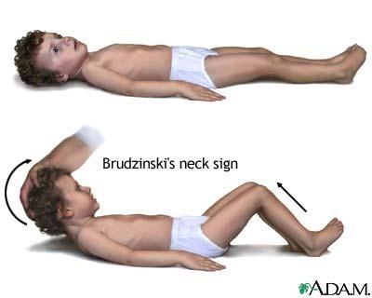
The Brudzinski sign is positive if knee and hip flexion occurs when the neck is flexed while the patient is in the supine position.

Slide 12
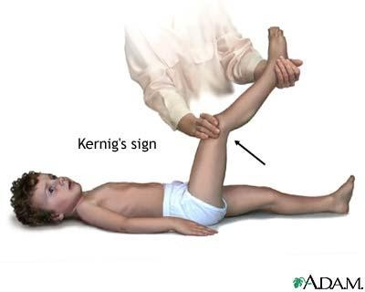
The Kernig sign is positive if pain in the lower back or posterior thigh occurs when the knee is extended while the patient is lying in the supine position and the hip is flexed at a right angle.
KERNIG SIGN:

Slide 13
DIAGNOSIS CONT
NECK STIFFNESS:
Nuchal rigidity is typically assessed with the patient lying
supine, and both hips and knees flexed.
INVESTIGATIONS DONE:
Blood test- FHG
Chest X-ray
CSF analysis
CT scan or MRI (MRI preferred over CT due to its superiority in demonstrating areas of cerebral edema, ischemia, and meningeal inflammation)
Cultures of samples of CSF, blood, urine, mucus from the nose
and throat, and pus from skin infections

Slide 14
If the disease is left untreated, the following manifestatations are seen:
Increased spinal fluid pressure
Myocarditis: inflammation of the heart
Hydrocephalus (blockage of spinal fluid in brain)
Mental retardation
Deafness :Loss of hearing from infiltration of the 8th nerve
Brain damage:Spread from the meninges to the brain is called meningoencephalitis
Severe diarrhea and vomiting
Internal bleeding
Low blood pressure
Shock
Death

Slide 15
TREATMENT
Because bacterial meningitis is a medical emergency, and treatment should be started immediately.
Bacterial meningitis is treated with antibiotics, intravenous (IV) antibiotics with a corticosteroid (eg, Dexamethasone) to bring down the inflammation before all the test results are even known.When the specific bacteria are identified, he may decide to change antibiotics or not.
In addition to antibiotics, it is important to replenish fluids lost from fever, loss of appetite, sweating, vomiting and diarrhea

Slide 16
Complications can require additional treatment.
Anticonvulsants (eg, Diazepam or Phenytoin) might be given for seizures.
Additional IV fluids in case of shock or low blood pressure.
Supplemental oxygen or mechanical ventilation if the child has difficulty breathing.
All neonates should have a hearing test following their recovery to screen for hearing impairment

Slide 17
PREVENTION
IMMUNIZATION:
Haemophilus influenzae type b (Hib) vaccine
Part of the recommended immunization schedule in children.
CHEMOPROPHYLAXIS:
Rifampin is given to family members of an infected person to reduce their risk of contracting the disease as H influenzae can persist in the nasopharyngeal secretions even after a successful treatment.
Pregnant women should not take rifampin as it may harm the fetus.They should be treated with single doses of ciprofloxacin, azithromycin, or ceftriaxone

